Slide 1
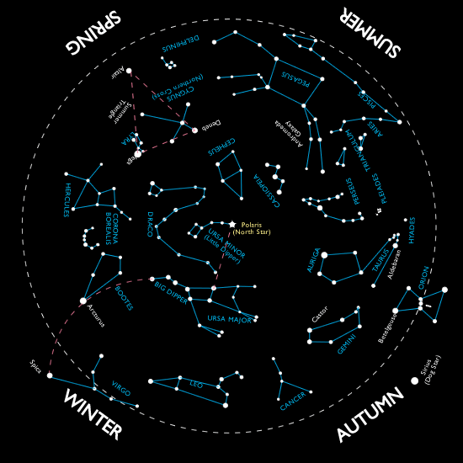
Unit 2: Stellar Evolution and Classification …The stars are a lot more than belonging to constellations!
Unit 2
Miss Cohn

Slide 2
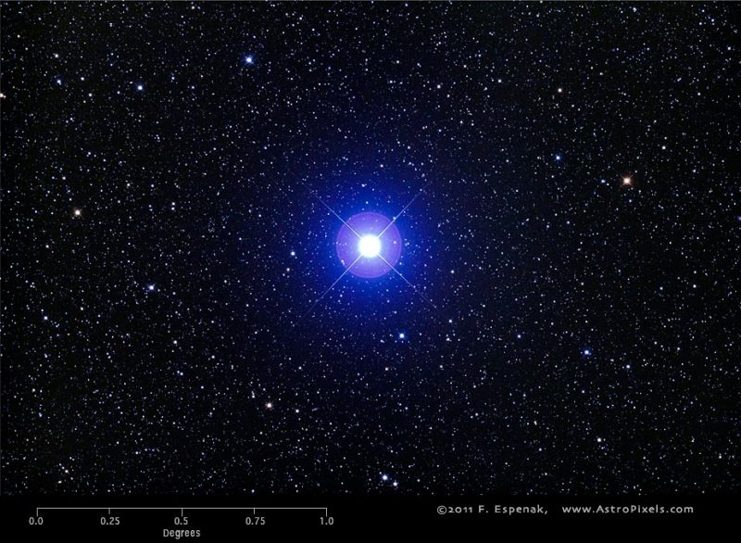
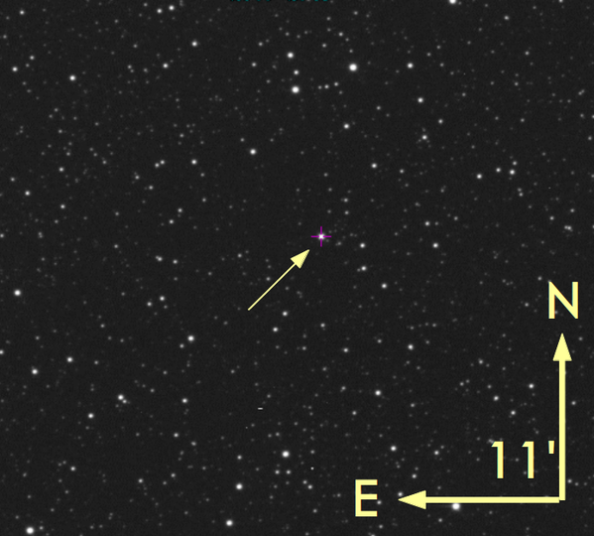
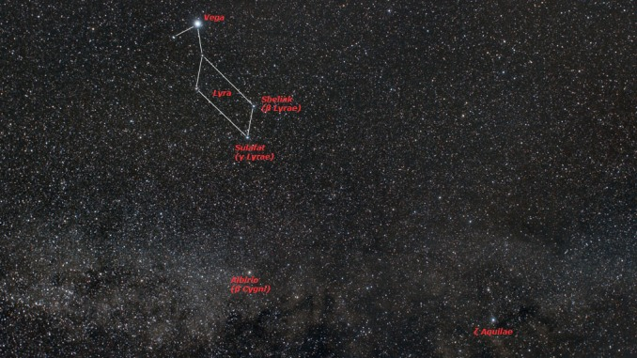
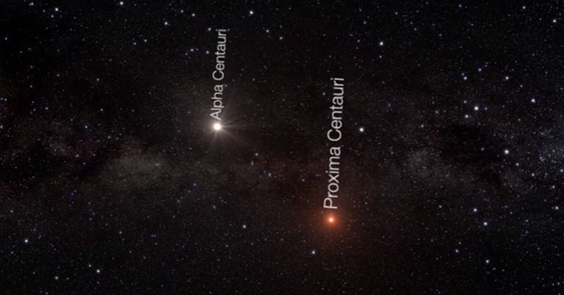
How do stars differ? ← Vega (25 light years)

Slide 3
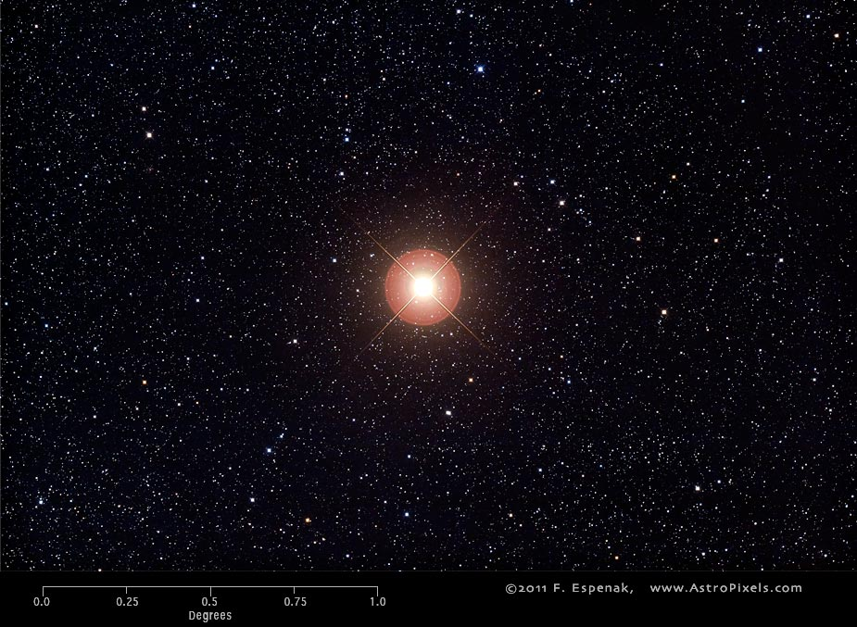
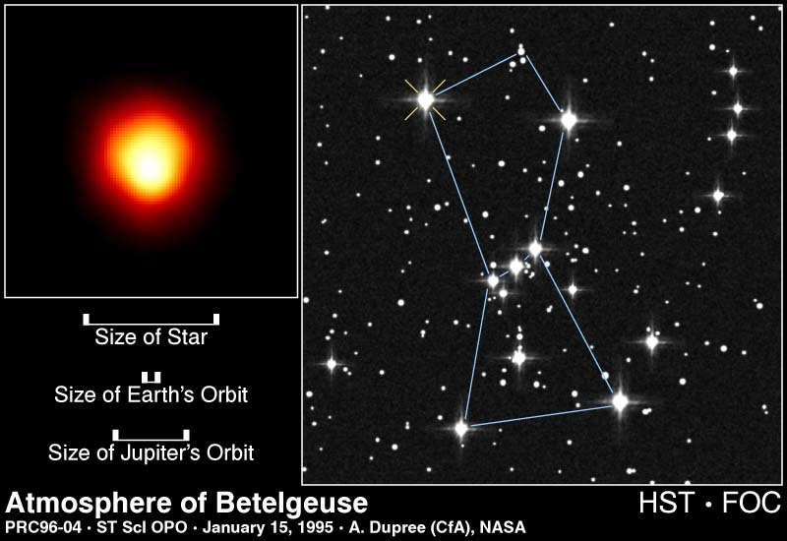
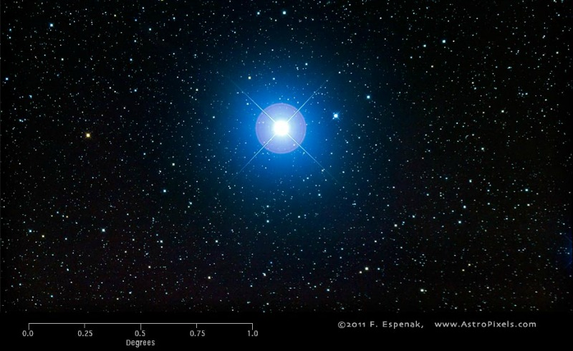
Betelgeuse (640 light years) and Rigel (~860 light years) in Orion – both supergiant's

Slide 4
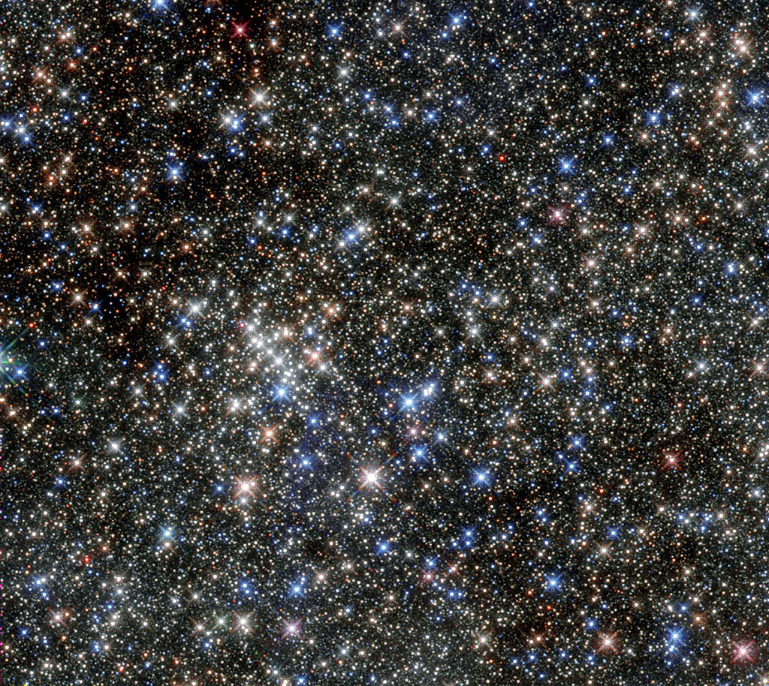
The view 25,000 light years from Earth, towards the center of our galaxy, Sagittarius A. The Pistol star is the brightest, just below the center of the image
By ESA/Hubble, CC BY 4.0, https://commons.wikimedia.org/w/index.php?curid=41549596

Slide 5
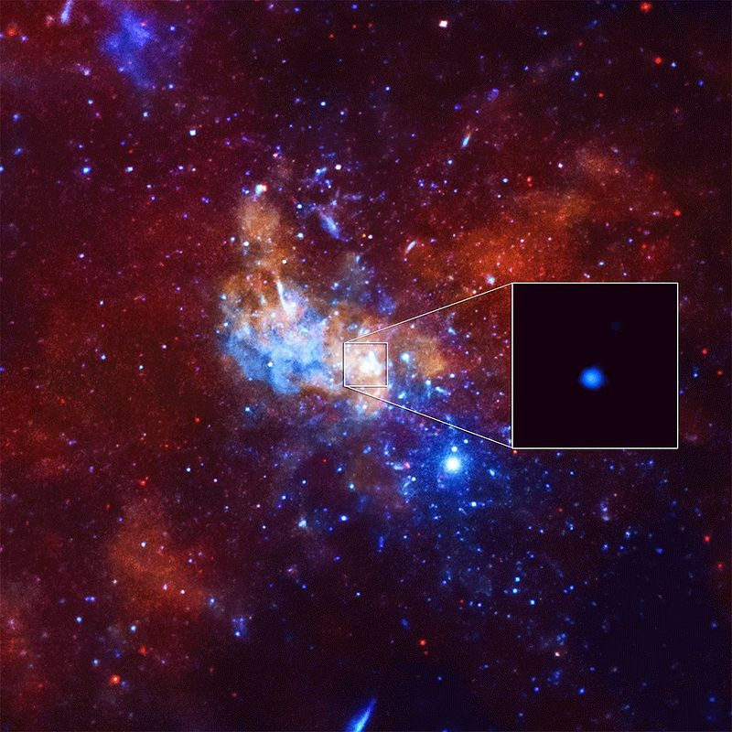
And at the center of the milky way, 27,000 light years from Earth, lies Sagittarius A , a supermassive black hole!

Slide 6
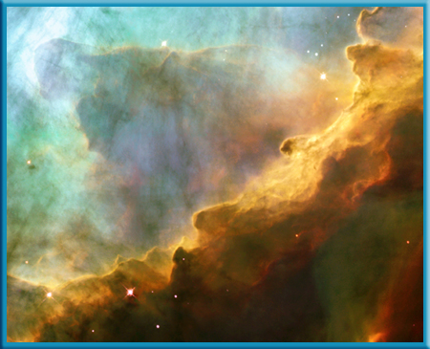
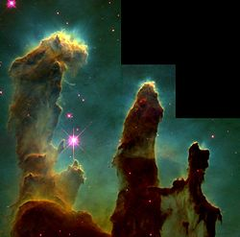
The life cycle of a star…
It all begins as a NEBULA, a dense cloud of dust and hydrogen gas. As matter coalesces, gravity INCREASES, and pulls more matter inwards over time (~10 + m.y)

Slide 7
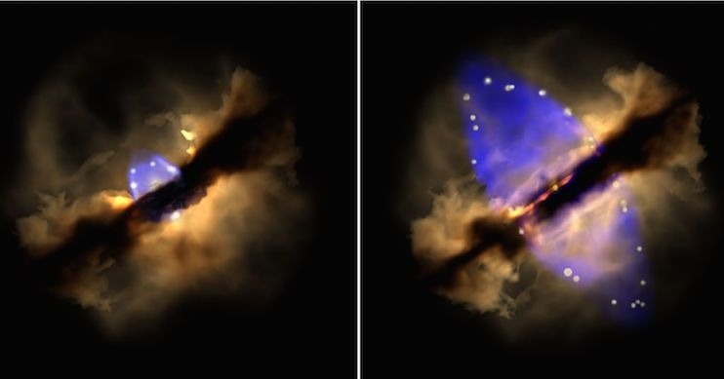
As mass INCREASES, gravity increases, the nebula begins to contract. The pressure and temperature increase enough to become a PROTOSTAR.

Slide 8
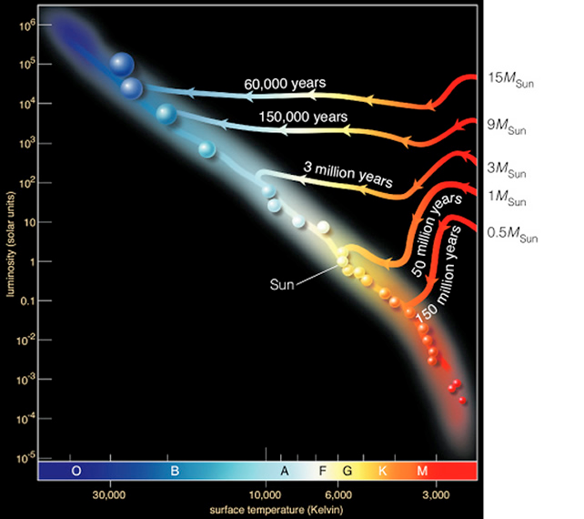
If the temperature exceeds 10 million K, NUCLEAR FUSION will occur, and a star is born as a MAIN SEQUENCE Star. A star will spend 90% of all its life in this stage, Fusing hydrogen (the fuel) in its core into HELIUM atoms.

Slide 9
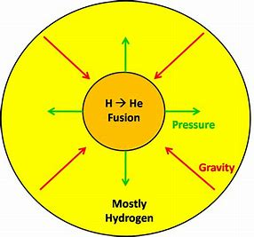
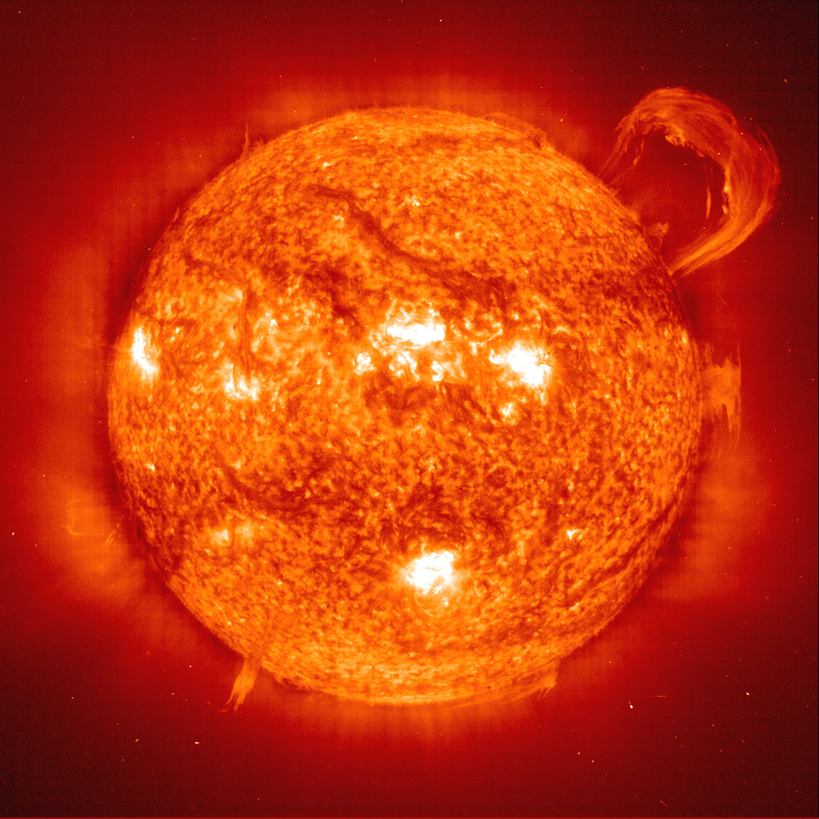
During this time, a star is in EQUILIBRIUM, where the OUTWARD force of fusion (holding up the gaseous star), and the INWARD force of gravity (pulling matter inward) are roughly equal. But over time, the main sequence star loses MASS as fusion continues…

Slide 10
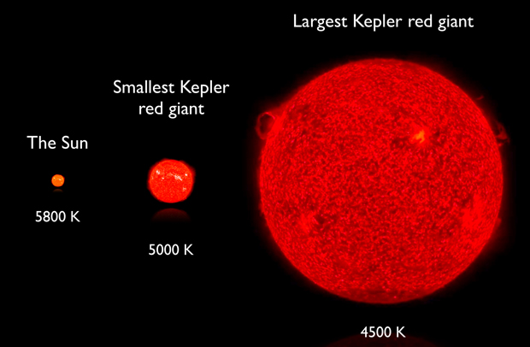
As hydrogen begins to run out, fusion SLOWS, and gravity wins, contracting the star. This increase in pressure drives internal core temperatures HIGHER, now Helium will begin to fuse CARBON. The star EXPANDS and COOLS, becoming a RED GIANT or SUPERGIANT
The force of fusion becomes greater than the inward pull of gravity and the star grows

Slide 11
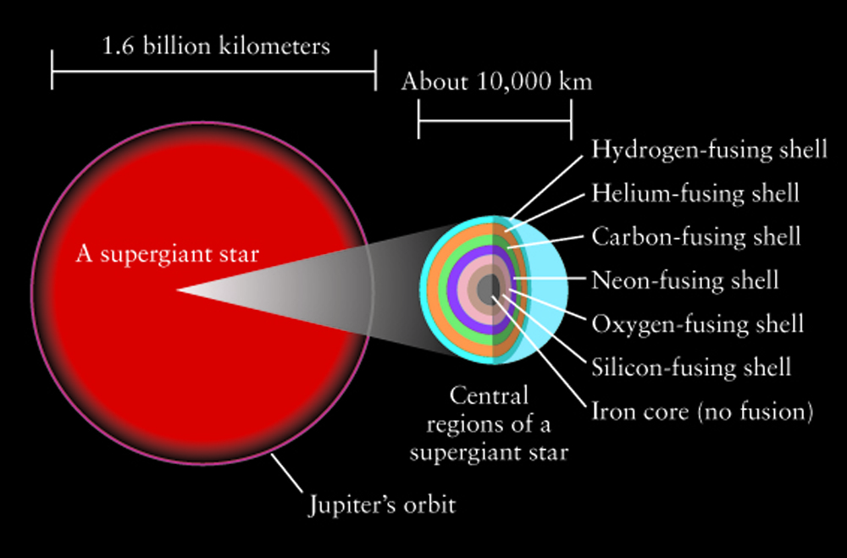
Supergiant's will fuse heavier atoms than carbon during this stage, as they generate greater internal pressures, thus temperatures for fusion reactions to occur.
He→C
C→ O, Mg, Si, Ne, Si until Fe…

Slide 12
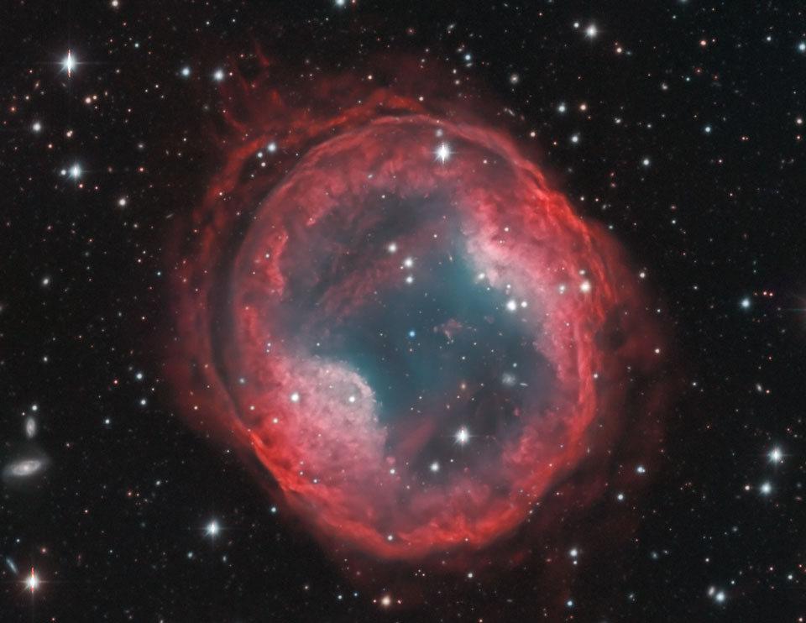
In an average to low mass star, fusion ceases to continue after the red giant stage. The outer layers of the star are expelled, creating a Planetary Nebula

Slide 13
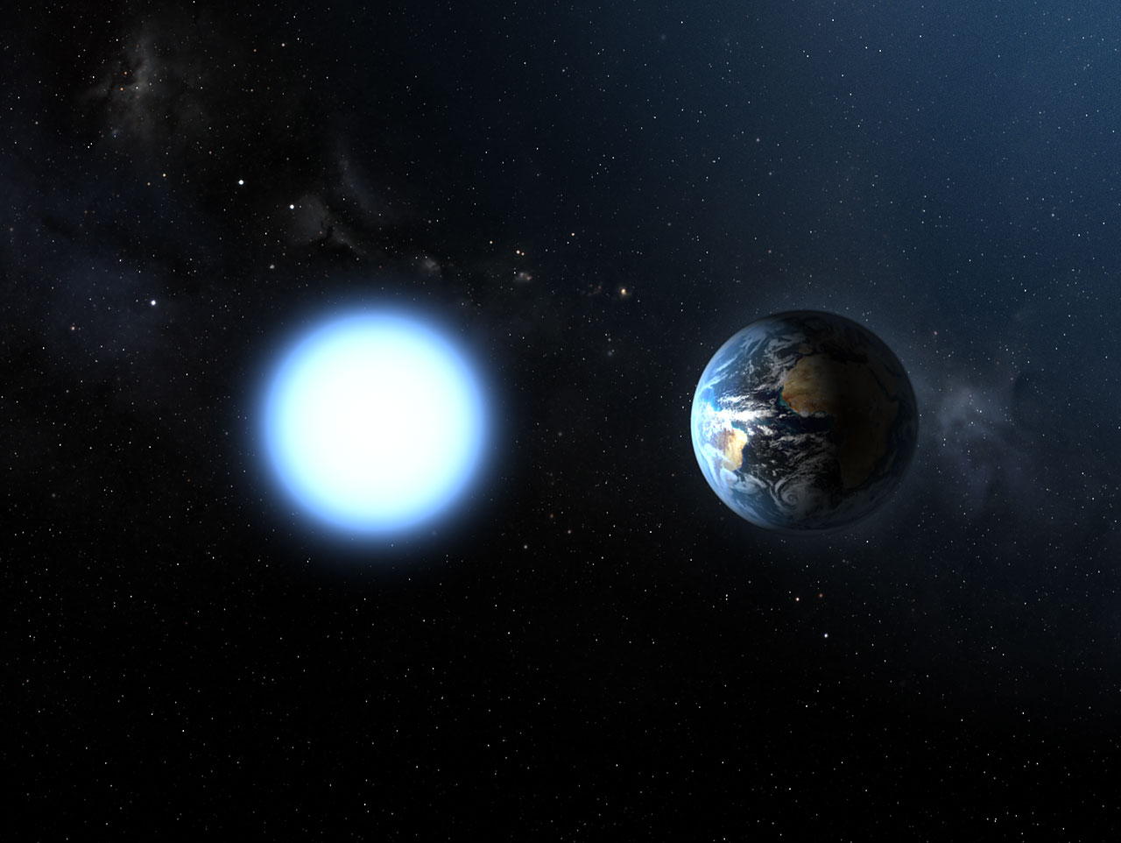
The star continues to glow, as its center region, the core continues to emit light created from prior fusion reactions. Gravity wins, contracting the star into a WHITE DWARF; hotter but far less luminous.

Slide 14
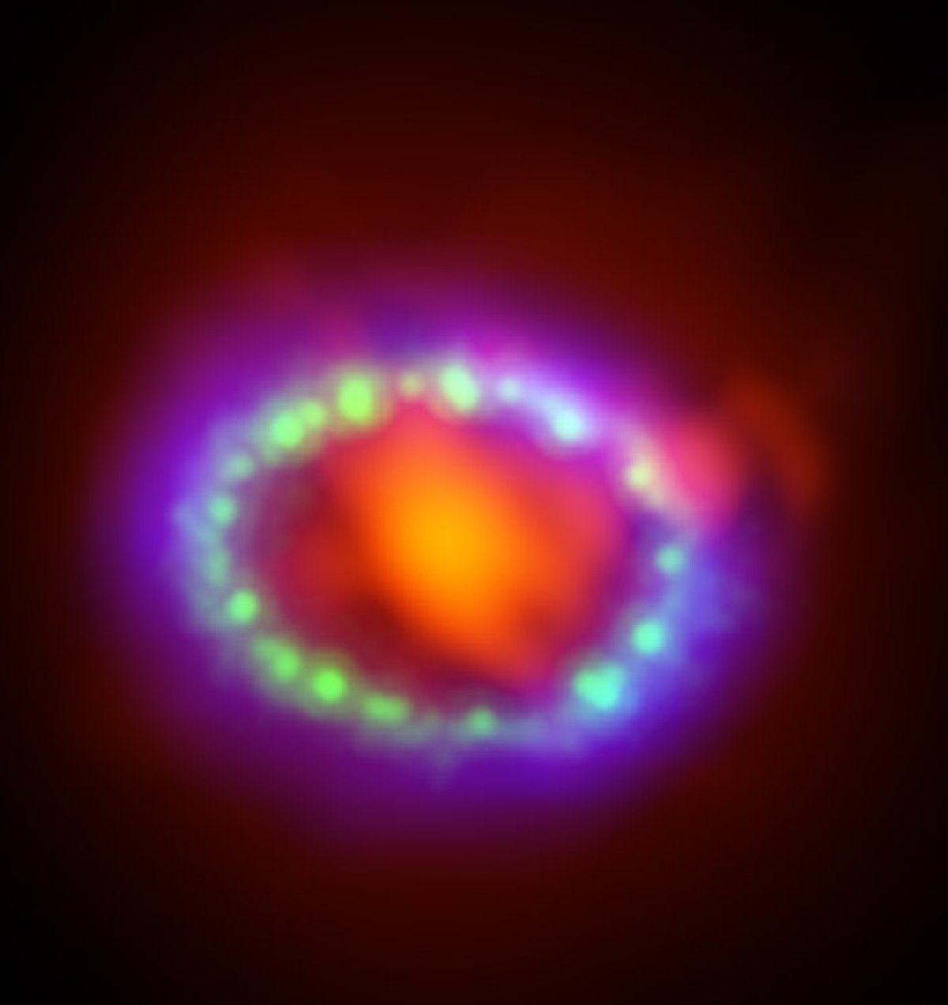
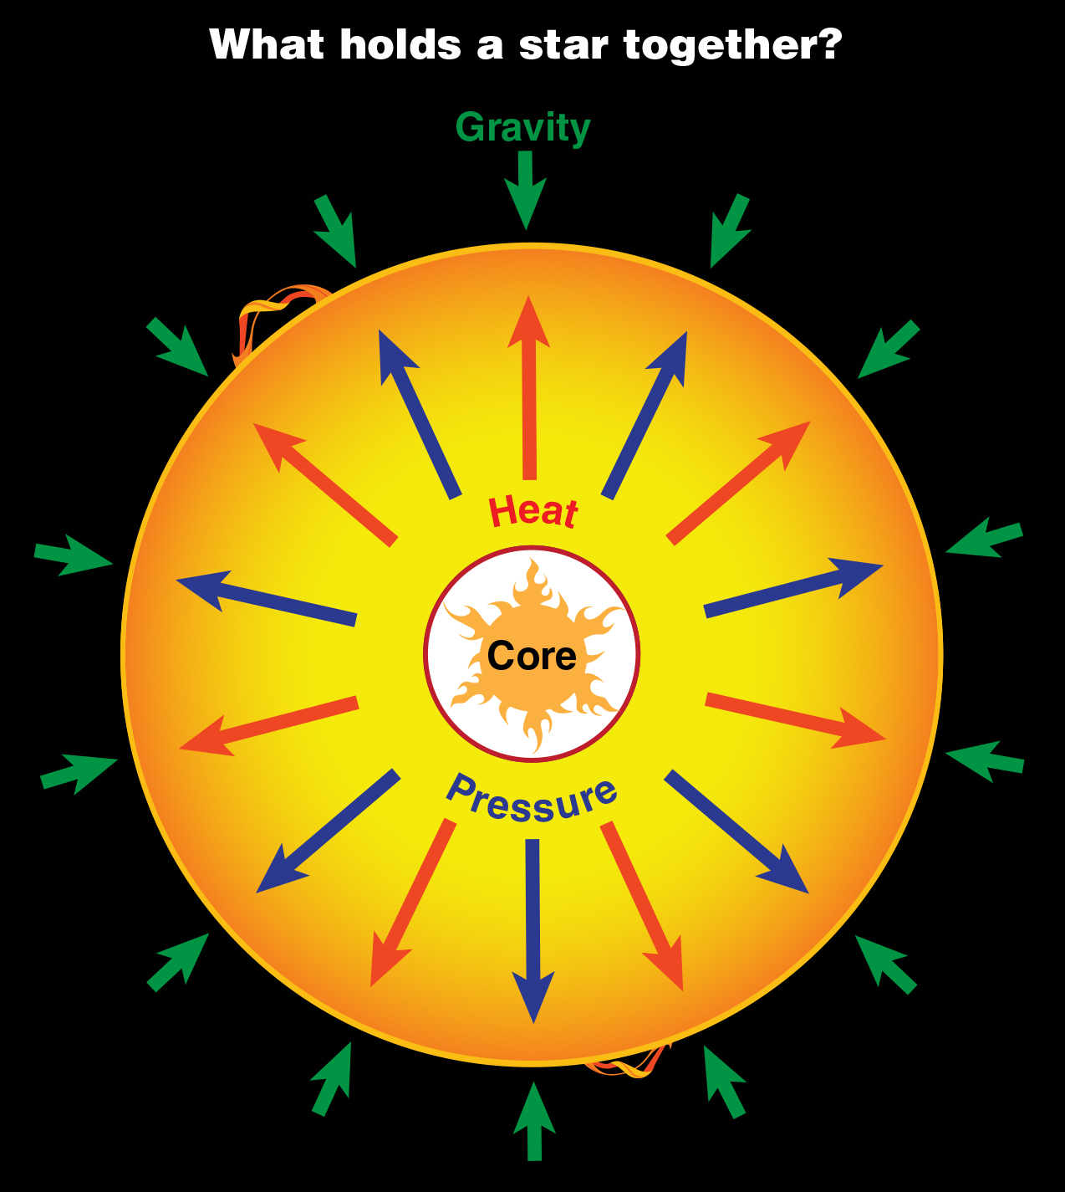
Massive stars have the ability to keep fusing elements until they get to iron. When silicon fuses to form iron, there is more energy taken than what is released by fusion. Thus gravitational collapse, or an implosion occurs. This creates a SUPERNOVA explosion!
Last seen supernova outside our milky way, noted in 1987. It was 168,000 light years away!.

Slide 15
Massive stars will create NEUTRON STARS, stars made entirely out of neutrons (heaviest part of the atom) due to the intense gravitational collapse. A teaspoon would weigh more than all of the automobiles in the U.S.!
Neutron stars could collide with other neutron stars to become black holes while some other stars could eventually die out and become planets as the matter is left over.

Slide 16
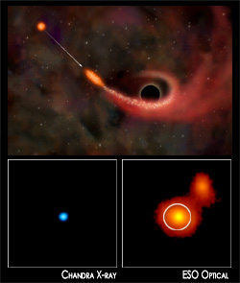
Supermassive stars end up as BLACK HOLES
A black hole is a space where gravity pulls so strongly, not even light can escape it.
Thus, we can not see black holes in visible light
They form from the same gravitational
collapse of the supernova
Chandra x-ray observatory (NASA)
currently observes images of black holes

Slide 17
Questions to answer in summary
1.) What determines the length of time a star lives?
2.) What determines whether a star will end up as a white dwarf, neutron star or black hole?
3.) Whether a star expands, contracts, or remains in equilibrium is entirely dependent upon which two forces?
4.) Which process creates electromagnetic energy in stars?

Slide 18
PART II: Stellar Classification/ H-R Diagram. Devized by Hertsprung and Russel (1910). Measures:

Slide 19
Vocabulary:
Luminosity:
Our sun’s Luminosity
Is the actual brightness of a star, or rate of total energy emitted compared to our sun in (Units=Watts/second)
Absolute Magnitude-
a stars brightness at a standard distance (All stars are plotted at absolute magnitude on the H-R diagram)
= 3.85 x 10^26 Watts/second! (actual)
We compare other stars to the sun which has a luminosity of “1” comparatively
*Note luminosity is logarithmic on an H-R diagram

Slide 20
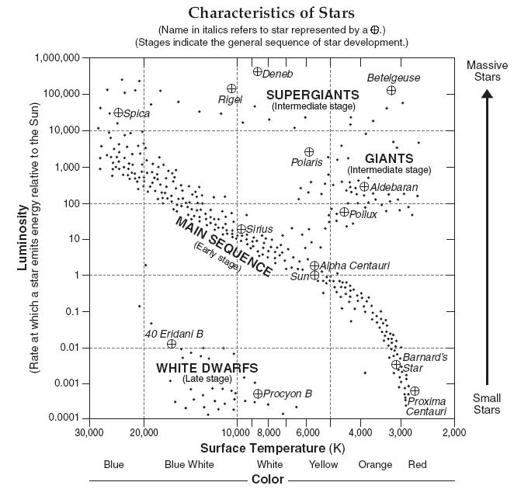
What determines a stars luminosity?
Q: Why does Betelgeuse, have approximately a temperature of 3,000 K and have a luminosity +100,000x that of the sun if it is a cooler star?

Slide 21
Key concepts:
1.) The brightest stars are the BIGGEST stars. It is SIZE that determines a stars overall brightness. Generally speaking, the brighter stars are the bigger stars because the bigger stars are also burning through their fuel at a faster rate.
2.) Within the MAIN SEQUENCE star group, temperature does change the overall luminosity of a star. Bigger main sequence stars will fuse elements faster, generating more heat, and thus greater luminosities.
3.) Blue stars are the hottest, and red, the coolest

